Slide 1

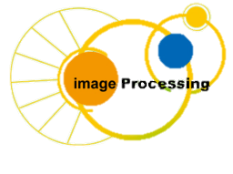
C Programing
Prof. John Y. Chiang
Dept. of Computer Science & Engineering
National Sun Yat-sen University
chiang@cse.nsysu.edu.tw
http://image.cse.nsysu.edu.tw

Slide 2
Contents
1 C Overview
2 Selection and Decision
3 Repetition and Loops
4 Function
5 Arrays
6 Pointers I
7 Pointers II
8 Structure
9 Link list
10 Class and object

Slide 3
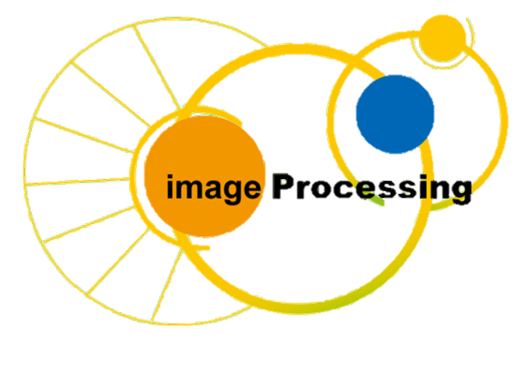
Lecture 1
C Overview

Slide 4

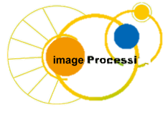
給新進程式員建議：五大理由需要學習 C 語言
1. 簡單易學
2. 沒有捷徑，你只能被迫從基礎練習
3. 你不能逃避記憶管理
4. 有趣的 Bit 、 Bytes 及數據類型
5. 學習 C 語言後不會再對新程式語言感到害怕
1

Slide 5

The C Language
Introduction to C:
  Developed between 1969 and 1973.
  By Dennis Richie, from B written by Ken
  Thompson.
  At AT&T Bell Labs.
  To write UNIX (Linux is a first cousin).
  powerful and flexible
  “High-level assembly”.
Dennis Richie

Slide 6
The C Language
We use ANSI C (American National Standards Institute). C programs commonly contain:
  preprocessor directives.
  compiler directives.
  executable code.
  comments for the reader.
ANSI C must have certain standard libraries in its implementation

Slide 7
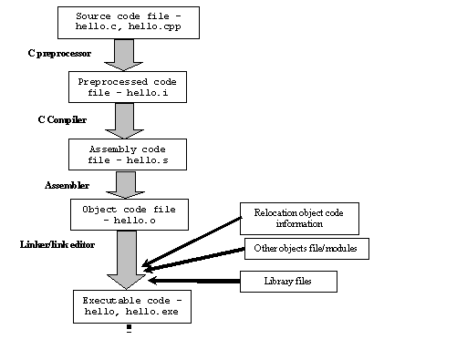
C compilation

Slide 8
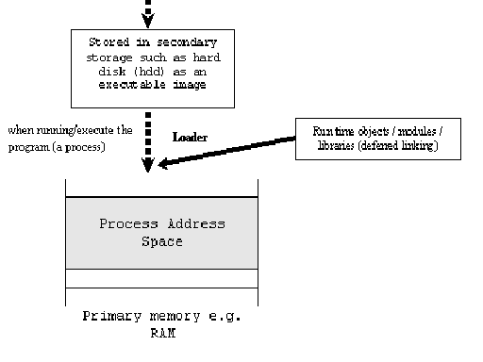
C compilation

Slide 9
Preprocessor Directives
The preprocessor is a specialized text editor that is not (usually) part of the compiler. It uses a different syntax than C.
  Instructions to the preprocessor begin with #.
  They are terminated at the end of the line, but may be continued to the next line with a slash (/).

Slide 10
Preprocessor Directives
  They come first, before C code.
  they cause modification of code before the program is compiled.
  Ex.
  #include<stdio.h>
  #define YEAR 1776

Slide 11
Preprocessor Directives
  The #include<stdio.h> gives a program access to the standard I/O library, its constants, and its input/output functions.
  library has a standard header file whose name ends with .h.

Slide 12
Pieces of C
  Types and Variables
      Definitions of data in memory
  Expressions
      Arithmetic, logical, and assignment operators in an infix notation
  Statements
      Sequences of conditional, iteration, and branching instructions
  Functions
      Groups of statements and variables invoked recursively

Slide 13
Complete C program
  Functions
Variables
Statements
Expressions

Slide 14
Complete C program
  Function
      int main(void) is the beginning of the main function; execution begins here.
      The rest is the body of the function, enclosed in { } The body has:
          Variable declarations
          Arithmetic logical expression
          Executable statements.

Slide 15
Complete C program
  Variables
      Declarations allocate storage, name, and type it.
      named memory locations where values may be stored.
      Named entities (variables, constants, function names) are identifiers and the names must follow certain rules

Slide 16
Naming Conventions
  Principles:
      Start with a letter or underscore.
      Contain letters, digits, __.
      No blanks, commas, special characters.
      Cannot be more than 31 characters.

Slide 17

Naming Conventions
  Must conform to case sensitivity.
  Ex.
Valid and invalid naming

Slide 18
Naming Conventions
  Cannot be a C keyword.
  Ex.
auto | double | int | struct
break | else | long | switch
case | enum | register | typedef
char | extern | return | union
const | float | short | unsigned
continue | for | signed | void
default | goto | sizeof | volatile
do | if | static | while
C keywords

Slide 19
Variables and Constants
  A variable is a symbolic name associated with a physical address.
  Defined constants associate symbolic names with constant values.
  By convention, variable names are mostly lower case; constants are upper case.
  Use mnemonic names !

Slide 20
Data Types
  Data type: A set of values and a set of operations defined for those values.
  The four standard types in C:
      Int
      Float
      Double
      Char

Slide 21

Data Types
  Int (4 bytes):
      Represents any positive/negative number and zero; values have no decimal point. The system (usually) won’t convert a floating point to an integer value.
      range of values is up to +- 2,147,483,647
  Ex.

Slide 22
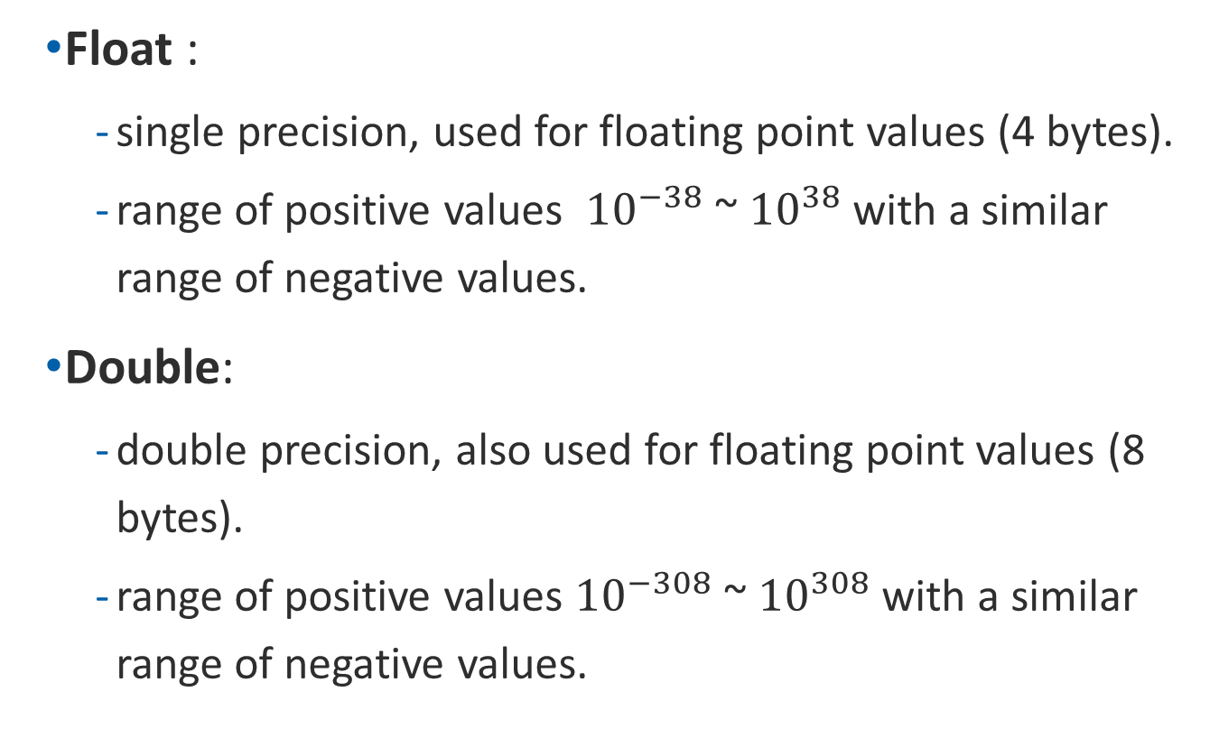
Data Types
  Float :
      single precision, used for floating point values (4 bytes).
      range of positive values ${10}^{−38}$~ ${10}^{38}$with a similar range of negative values.
  Double:
      double precision, also used for floating point values (8 bytes).
      range of positive values ${10}^{−308}$~ ${10}^{308}$with a similar range of negative values.

Slide 23
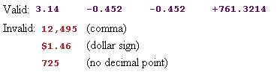
Data Types
  Both float and double values require a decimal point. The system will convert integers to floating point values when necessary.
  Ex.

Slide 24
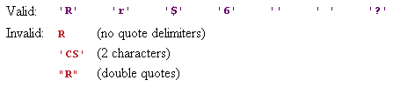
Data Types
  Char (1 byte):
      Represents a single character, in ASCII.
      Use single quotes as delimiters.
      We use the ASCII character set of 128 characters.
  Ex.

Slide 25
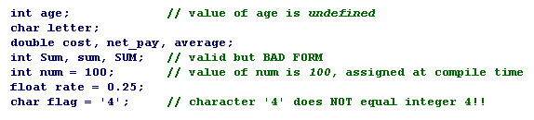
Program Variables
  A variable has a programmer-defined name for a memory location, and its value may be changed by the program.
  By convention, variable names are usually lower case.
  Ex.

Slide 26
Constants
  Any value that will not change during the life of a function should be a constant, not a variable.
  The use of constants improves readability.
  If we want to use a different constant value, we can make the change in one place and have that change available throughout.

Slide 27
Constants
  At compile time, a programmer may define a symbolic name for a constant value.
  Symbolic constants cannot be changed by the program.
  By convention, constant names are UPPERCASE.
  Const is a compiler directive that creates a constant.

Slide 28
Constants
  Syntax: const <type> <symbolic name> = <value>;
  Ex.
      const int CARDS = 52;
      const float PI = 3.14159;
      const char CODE = 'd';
      const int FALSE = 0;

Slide 29
Constants
  What is the meaning of each:
      #define DEMO1 'Y'
      // no quotes in code: answer = DEMO1;
      #define DEMO2 Y
      // need quotes in code: answer = 'DEMO2';
      const char DEMO3 = 'Y';
      // no quotes in code: answer = DEMO3;
      char DEMO4 = 'Y';
      // no quotes in code: answer = DEMO4;

Slide 30
Constants
  Notice in #define:
      There are no types, equals, or semi-colons.
      This is because of the way the preprocessor replaces the constant macro name with the constant value before the program is compiled

Slide 31
Constants
  It is legal to use arithmetic expressions and other defined constants in #define directives.
  Ex.
      #define PI 3.14159
      #define RADIUS 100
      #define AREA PI * RADIUS *RADIUS

Slide 32
More Constants
  Example: the “min” function
      int min(int a, int b)
      { if (a < b) return a; else return b; }
      #define min(a,b) ((a) < (b) ? (a) : (b))
  Identical for min(5,x)
  Different when evaluating expression has side-effect:
      min(a++,b) -> a++ < b ? a++ : b
      min macro may increment a twice if a < b

Slide 33
More Constants
  Text substitution can expose unexpected groupings
      #define mult(a,b) a*b
      mult(5+3,2+4)
      Expands to 5 + 3 * 2 + 4
      Operator precedence evaluates this as
      5 + (3*2) + 4 = 15 not (5+3) * (2+4) = 48 as intended
  Moral: By convention, enclose each macro argument in parenthesis:
      #define mult(a,b) (a)*(b)

Slide 34
Assignment Statements
  Syntax: <variable> = <expression>;
  What is the semantics (meaning)?
      x = 7;
      letter = 'M';
      y = y + 1; // add 1 to y
      y++; // add 1 to y
      ++y; // add 1 to y
      area = PI * radius * radius;
      // not the same as constant RADIUS

Slide 35
Assignment Statements
  Assign values at compile time:
      <type> <name> = <expression>;
      int number_items = 0;
      float cost = 24.95 + TAX;
      char code = 'X';

Slide 36
Assignment Statements
  Assign values at run time:
      <type> <name>;
      int number_items;
      float cost;
      char code;
      <name> = <expression>;
      number_items = 0;
      cost = 24.95 + TAX;
      code = 'X' + 1;

Slide 37
I/O: formatted print and scan
  Output:
      Syntax:
      printf(<format string>, <(optional) print list>);
      printf() is a function with one or more arguments. It converts values to a printable form, then displays them.

Slide 38
I/O: formatted print and scan
  \n:
      one of several escape sequences defined by C to represent special characters.
      It is the line feed character and it moves the cursor to the beginning of the next line.
      If you leave out the \n, you will find that there is no line advance after the output is printed. If you try something like
      printf(“hello, world
      “);
      the C compiler will produce an error message.

Slide 39
I/O: formatted print and scan
  Other commonly used escape sequences are
      \t the tab character;
      \f the form feed character;
      \b the backspace character.
  Constant ‘\0’ represents the character with value zero, the null character.

Slide 40
I/O: formatted print and scan
  Ex.
  printf("I have %d baseball cards.",number);
  printf("\nAverage:%f Grade:%c\n",average, letter);
  printf("Hello!");
  printf("\n"); // go to a new line
  printf("\n\n"); // skip a line
Instruction arguments
instruction name
format string
print list

Slide 41
I/O: formatted print and scan
  Assume these values:
  number = 500 , letter = B , average = 89.965
  Output:
  I have 500 baseball cards.
  Average: 89.965000 Grade: B
  Hello!
  -- blank line --
  -- blank line --
  [cursor]

Slide 42
I/O: formatted print and scan
  I/O Placeholders begin with % and indicate where a run-time value will be displayed (output) or stored (input).
      %c convert to/from character
      %d convert to/from integer
      %f convert to/from float
      %lf convert to/from double
      %s convert to/from string

Slide 43
I/O: formatted print and scan
  Input:
      Syntax:
      scanf(<format string>, <variable address list>);
      scanf() is a function with two or more arguments. It reads values and converts them to a machine readable format.

Slide 44
I/O: formatted print and scan
  Ex.
    float radius; // radius of water tower
    int length; // length of copper pipe
    scanf("%d", &x);
    scanf("%d%d", &x, &y);
    scanf("%c%f%lf", &code, &cost, &debt);
    scanf("%f%d", &radius, &length);
  radius and length are variables where data can
  be stored.

Slide 45
I/O: formatted print and scan
  Variables of type char are different!
      scanf("%d%c", &x, &ch);
      on input 7<blank>A stores a blank in ch.
      scanf("%d %c", &x, &ch);
      on input 7<blank>A stores A in ch.
  A blank space before %c informs the system to ignore white spaces; without the space the blank is treated as an input character.

Slide 46
I/O: formatted print and scan
  More I/O:
  Ex1.
      int x, y, z;
      scanf("%d%d%d", &x, &y, &z);
      printf("%d %d %d\n", x, y, z);
      printf("%d %d %d\n", z, x, y);
      input: 40 -8 6
      output: 40 -8 6
      6 40 -8
      Final values: x = 40 y = -8 z = 6

Slide 47
I/O: formatted print and scan
  Ex2.
      scanf("%d%d%d", &x, &y, &x);
      printf("%d %d %d\n", x, y, x);
      input: 40 -8 6 23
      output: 6 -8 6
      Final values? x = y =

Slide 48
I/O: formatted print and scan
  Ex3.
      scanf("%d%d%d", &y, &x, &y);
      printf("%d %d %d %d", x, y, x, x);
      input: 40 -8 6 37
      output: -8 6 -8 -8
      Final values? x = y =

Slide 49
I/O: formatted print and scan
  Common data types:
      char %c
      float %f
      int (2s-complement) %d
      unsigned int %u
      hex %x
      octal %o
      double %lf

Slide 50
Arithmetic Expressions
  Arithmetic:
  Note:
  integer division quotient
  modulo arithmetic remainder

Slide 51
Arithmetic Expressions
  Ex.
      17 / 5 ---> 3
      5 / 17 ---> 0
      17 % 5 ---> 2
      5 % 17 ---> 5
  Note: % requires positive integer operands.

Slide 52
Arithmetic Expressions
  Precedence

Slide 53
Arithmetic Expressions
  Ex.
      What is value of: 9 + 3 * 2 + 12 / 4
      This is the same as:
      9 + (3*2) + (12/4)
      9 + 6 + 3
      18

Slide 54
Arithmetic Expressions
  Mixed Mode Arithmetic and Data Type Hierarchy:
      Mix mode arithmetic involves calculations with mixed data types. Highest mode determines the mode of the operation.
      Data type hierarchy, high to low:
          double
          float
          int

Slide 55
Arithmetic Expressions
  Ex1.
      20.5 / 5 ---> 4.1 5 is converted to 5.0
      20 / 5.0 ---> 4.0 20 is converted to 20.0
      20 / 6 * 2.0 ---> 6.0 Why?
      2.0 * 20 / 6 ---> 6.667 Why?

Slide 56
Arithmetic Expressions
  Ex2.
      float x, y;
      y = 20 / 6; // 20/6 is 3, converted to 3.0
      x = y * 5; // 3.0 * 5, converted to 5.0
      printf("y=%f; x = %f\n", y, x);
      // notice spaces in format
      Output: y=3.000000; x = 15.000000

Slide 57
Arithmetic Expressions
  Rules of evaluating expressions in assignment statements:
      Do right-hand-side using data type hierarchy.
      Convert result to left-hand-side type.
      Intermediate results follow type rules.

Slide 58
Arithmetic Expressions
  Ex1:
      float x;
      x = (4*2) + 24/5;
      //x is 12.0 because :
      //4 * 2 ---> 8, an integer
      //24 / 5 ---> 4, an integer and performed
      //before the addition
      //8 + 4 ---> 12, an integer
      //12 is converted to a float, 12.0.

Slide 59
Arithmetic Expressions
  Ex2:
      x = (4*2) + 24.0/5;
      //4 * 2 ---> 8, an integer
      //24.0 / 5 ---> 4.8, a float
      //8 + 4.8 ---> 8.0 + 4.8 ---> 12.8, all floats

Slide 60
Arithmetic Expressions
  Ex3.
      1) 20.0 / 3 * 20 / 3 = 44.4444
      2) 20.0 / (3*20) / 3 = 0.1111
      3) 20 / 3 * 20 / 3 = 40
      4) 20 / (3 * 20.0) / 3 = 0.1111
      5) 20.0 / 3 + 20 / 3 = 12.6667
      6) 20.0 / (3+20) / 3 = 0.2899
  Notice that all but 3) are doubles.

Slide 61
Arithmetic Expressions
  Shortcuts:
      Compound assignment:
          n = n + 5; or n += 5;
          // caution: order of precedent is different
          n = n * 5; or n *= 5;
          // caution: order of precedent is different
      Also valid for -= /= %=

Slide 62
Arithmetic Expressions
  Increment operator: ++
      x++; same as x = x + 1;
  Decrement operator:
      x--; same as x = x - 1;
  Multiple assignment:
      x = y = z = 0; // right to left execution
      same as z = 0;
      y = z;
      x = y;

Slide 63
Arithmetic Expressions
  Postfix vs. Prefix:
      Postfix: x++; Increment x after use.
      Prefix : ++x; Increment x before use.
      Ex1.
      x = 3;
      y = x++;
      y ---> 3 x ---> 4

Slide 64
Arithmetic Expressions
      Ex2.
          x = 3;
          y = ++x;
          y ---> 4 x ---> 4
      Ex3.
          x = 3;
          y = ++x + x;
          Compiler dependent!
          (Also avoid in printf() and other function calls)

Slide 65
Arithmetic Expressions
  Type Casting:
      Use type casting to change the type of a variable temporarily during an intermediate step of execution.
      Syntax: (<type>)<expression>

Slide 66
Arithmetic Expressions
  Ex.
      float x; int y; double z;
      x = (int)(2.5 + 3.1);//x is now 5.0
      x = 14; //x is 14.0
      y = 14.0; <--- illegal!
      x = 3.9;
      z = (int)x + x; //z is now 3 + 3.9 or 6.9

Slide 67
Arithmetic Expressions
  //The next two lines are functionally equivalent!
      z = (double)4/17;
      z = 4.0/17;
  //The next two lines do almost the same thing!
      y = (float)x/r;
      y = x/(float)r;
    Note: Casting does not modify the value of its variable, such as x or r above.

Slide 68
Arithmetic Expressions
  More Examples:
      float y; int x=8, r=3;
          y = (float)x/r; 8.0/3 ---> 2.667
          y = x/(float)r; 8/3.0 ---> 2.667
          y = (float)(x/r); float (8/3)---> 2.000
          y = x/r; float (8/3)---> 2.000
          y = x%r; ---> 2.000
          y = (float)(x%r); ---> 2.000
          y = (float)(x)%r;
  ---> illegal - mod requires an integer operand

Slide 69
Arithmetic Expressions
  What happens?
      int x; float y; int r;
      x = 4; r = 8;
      y = x/r; // y holds 0.0
      y = (float)x/r; // y holds 0.5
      y = x/(r * 1.0); // y holds 0.5
  Note: x is still 4, r is still 8.

Slide 70
Bitwise operator
  C provides six operators for bit manipulation; these may only be applied to internal operands, that is, char, short, int, and long, whether signed or unsigned.
& | bitwise AND
| | bitwise inclusive OR
^ | bitwise enclusive OR
<< | left shift
>> | right shift
~ | one’s complement (unary)

Slide 71
Bitwise operator
  left shift: shift the number data left several bits.
      11 = 00…001011
      11 << 1 = 00…010110 = 22
      11 << 2 = 00…101100 = 44
  right shift: shift the number data right several bits.
      11 = 00…001011
      11 >> 1 = 00…000101 = 5
      >> 2 = 000…00010 = 2
  Easily to say, shift means multiply/divide by two.

Slide 72
Bitwise operator
  bitwise not: switch 0 and 1of the number data in binary
      66 = 0100 0010 = 64 + 4
      ~66 = 1011 1101 = 189
  bitwise AND: compare two numbers, if the bits are equal at the same position, it output 1, otherwise 0.
      11 = 8 + 2 + 1 = 00…00001011
      &74 = 64 + 8 + 2 = 00…01001010
      00…00001010 = 8 + 4 = 10

Slide 73
Bitwise operator
  bitwise or: compare two numbers, if the bits have one more bits ‘1’ at the same position, it output 1, otherwise 0.
      11 = 8 + 2 + 1 = 00…00001011
      |74 = 64 + 8 + 2 = 00…01001010
      00…01001011 = 64+8+4+2 = 78

Slide 74
Bitwise operator
  bitwise xor: compare two numbers, if the bits have odd bits ‘1’ at the same position, it output 1, otherwise 0.
      11 = 8 + 2 + 1 = 00…00001011
      ^74 = 64 + 8 + 2 = 00…01001010
      00…01000001 = 64 + 1 = 65

Slide 75
Formatting Output Values
  Integer Formats:
      form: %<fieldwidth>d
      Ex.
          x = 23;
          printf("*%d,%3d,%4d\n", x, x, x);
      output: *23,_23,_ _23
      (The underscore represents a space.)

Slide 76
Formatting Output Values
  Floating Point Formats:
      Ex.
      printf("%d %8.2f", age, average);
      %8.2f means:
          allocate a total of 8 spaces for the output
          the decimal point requires one space
          2 digits go to the right of the decimal

Slide 77
Formatting Output Values
      If fewer than 8 spaces are needed, blanks are put to left (right justified).
      If more than 8 spaces are needed, the system still prints the correct value.
  Note: %.3f and %0.3f print the number with no
  space, as do %d and %c.

Slide 78
Formatting Output Values
      Display 234/-234 Using different Placeholders
Displayed
Displayed
Value
Format
Output
Value
Format
Output
234
%4d
_ 234
-234
%4d
-234
234
%5d
_ _ 234
-234
%5d
_ -234
234
%6d
_ _ _ 234
-234
%6d
_ _ -234
234
%2d
234
-234
%2d
-234
234
%6.4d
_ _ 0234
-234
%6.4d
_ -0234

Slide 79
Formatting Output Values
      Displaying x Using Format String Placeholders
      %6.2f
Displayed
Displayed
Value of x
Output
Value of x
Output
-99.42
-99.42
-25.554
-25.55
.123
_ _ 0.12
99.999
100.00
-9.536
_ -9.54
999.4
999.40

Slide 80
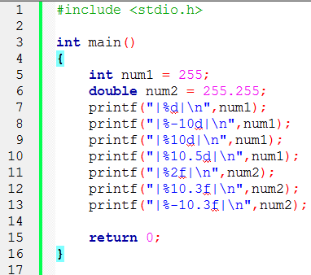
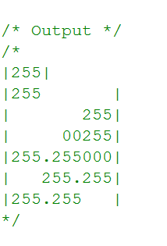
Formatting Output Values
  Ex.

Slide 81
Errors
  There are three errors:
      syntax error : Code violates grammar rules. Fix the first one, others often disappear. Code doesn't compile.
      run-time error : Code cannot run to completion. It tells computer to perform an illegal operation.
      logic error : Code terminates normally, but
          produces incorrect results, or
          does not solve the problem (faulty algorithm).

